Slide 1
Observations and the telescope

Slide 2
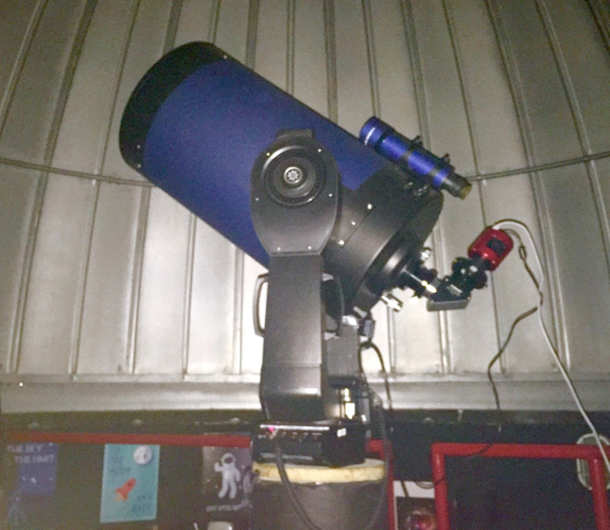
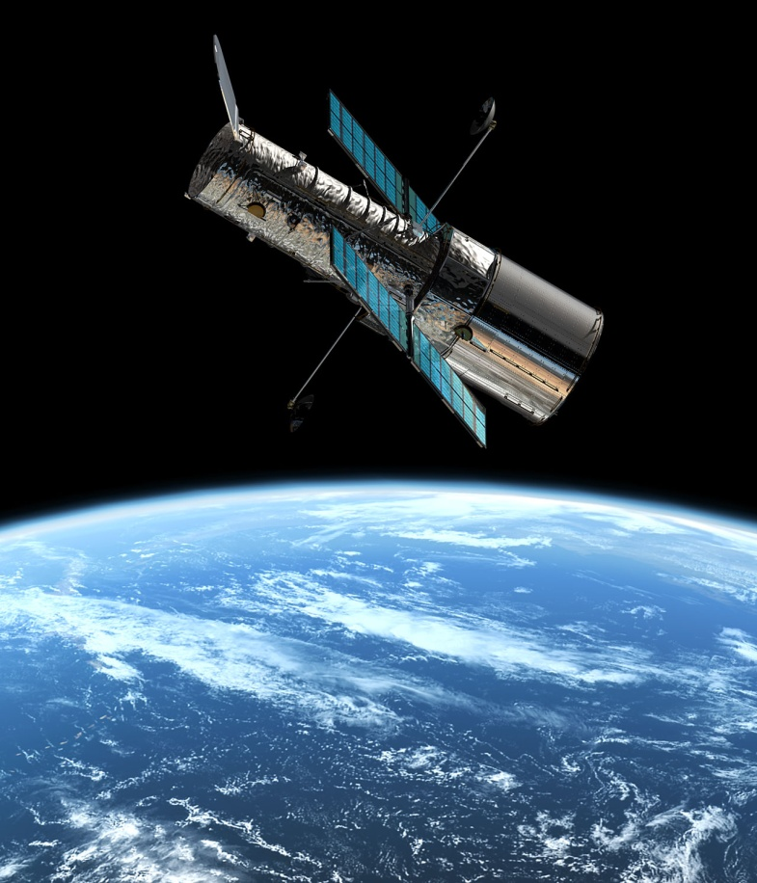
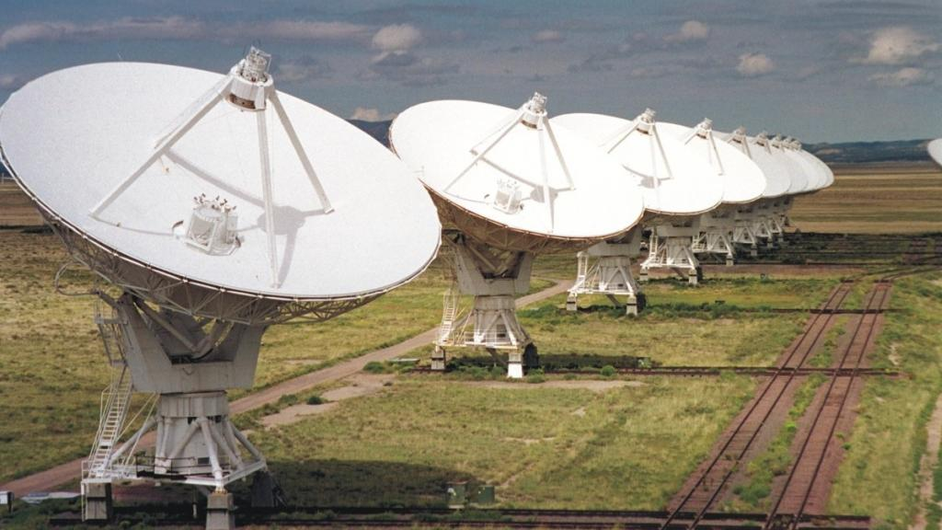
Telescopes come in an enormous amount of varieties.
Optical telescopes
Radio dishes
Satellites

Slide 3
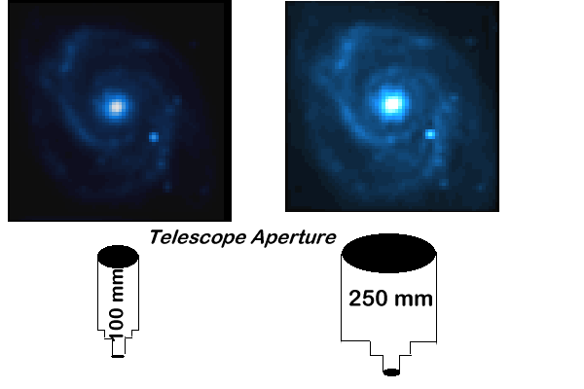
One common feature for optical telescopes is:
gathering light
the more light gathered in the scope, the more detail you can see!
Aperture- the diameter of its main, light-gathering
lens or mirror. (This lens or mirror is called the
telescope's objective.) The bigger the aperture,
the sharper and brighter the view will be.

Slide 4
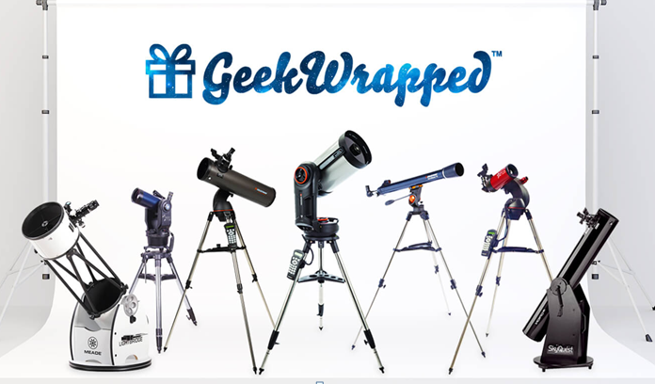
Our telescope: Meade Lx200 ACF 14” (355mm)
SCT with GPS/Autostar GOTO
Our telescope is special….it has a big aperture
compared to many regular telescopes.

Slide 5
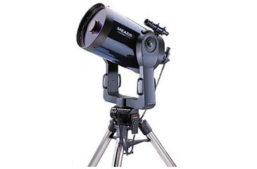
You will need to know the anatomy of our telescope
before you can use it for observations:
Finder scope- is a much smaller telescope aligned with the
main tube to provide a larger field of view for finding objects.
Finder scope

Slide 6
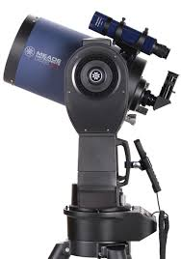
Eyepiece-The eyepiece for our scope is
Located at the back of the scope.
Do you remember how this is different from
the other scopes we looked at?
There are two types you should know
1.25” or 2”
Our scope has a 2” diagonal
and 2” eyepieces/lenses.
Eyepiece
diagonal

Slide 7
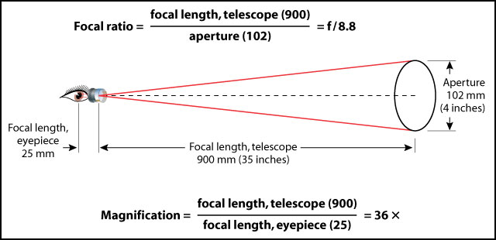
Let’s try some math….
Now-let’s try to find out our scope’s focal ratio:
our focal length is: 3556mm
our aperture is: 355mm (14”)
Focal ratio is ______
Can we improve the focal length? Magnification?

Slide 8
Eyepieces-
Eyepieces determine the magnification and field of view
of a telescope.
Different eyepieces are used to view different objects.
Some objects, such as nebulae and star clusters, appear
quite large
Nebulae and start clusters are best viewed at low
magnifications (which give a wider field of view)
Planets appear very small and are normally viewed with
high-magnification eyepieces.

Slide 10
We have the following eyepieces..26mm, 32mm, and 40mm)
We also have a Barlow 2x!
What is our possible magnifications?
Magnification = focal length telescope-3556mm
focal length eyepiece- 26mm
Magnification = focal length telescope-3556mm
focal length eyepiece- 32 mm
Magnification = focal length telescope-3556mm
focal length eyepiece- 40mm
How does the Barlow lense fit into this?

Slide 11
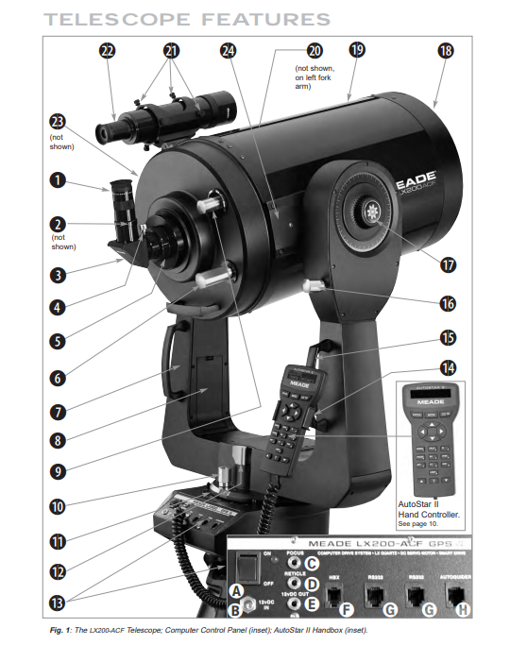
Parts of our telescope:
19. Tube-mirrors that make up
the functional part of the
Telescope.
8. Fork arm-holds the tube, and
contains mechanics to move the
tube.
6. Focus-use this to focus the
Image.
9. DO NOT TOUCH
13. Computer/GPS
14. Autostar-controls the
telescope

Slide 12
Telescope hand control with the Autostar:
Mode Key-go back to a previous menu, also used to find coordinates
Enter Key- select an option
Go To Key-point the telescope to the selected object
Speed Key-also labeled as “1” controls the speed at which the telescope moves. Options are 1 as the slowest and 9 as the fastest. A speed has to be chosen before the telescope will move.
The four opposing arrow keys in the middle of the hand controller move the telescope to look at an object.

Slide 13
Let’s get started:
SAFETY- NEVER LOOK DIRECTLY AT THE SUN –we
will be doing night time viewings only for now,
but remember this rule!
First the scope needs to be aligned to stars in the sky. We will
use the Autostar hand controller for that.
When each star is found we will check it in the finder scope to make
sure it is center in the “x”, then look through the telescope and
make sure it is centered.
3. This will be done for at least two stars.
Now we can let our handheld Autostar choose the best objects to
view for that night!

Slide 14
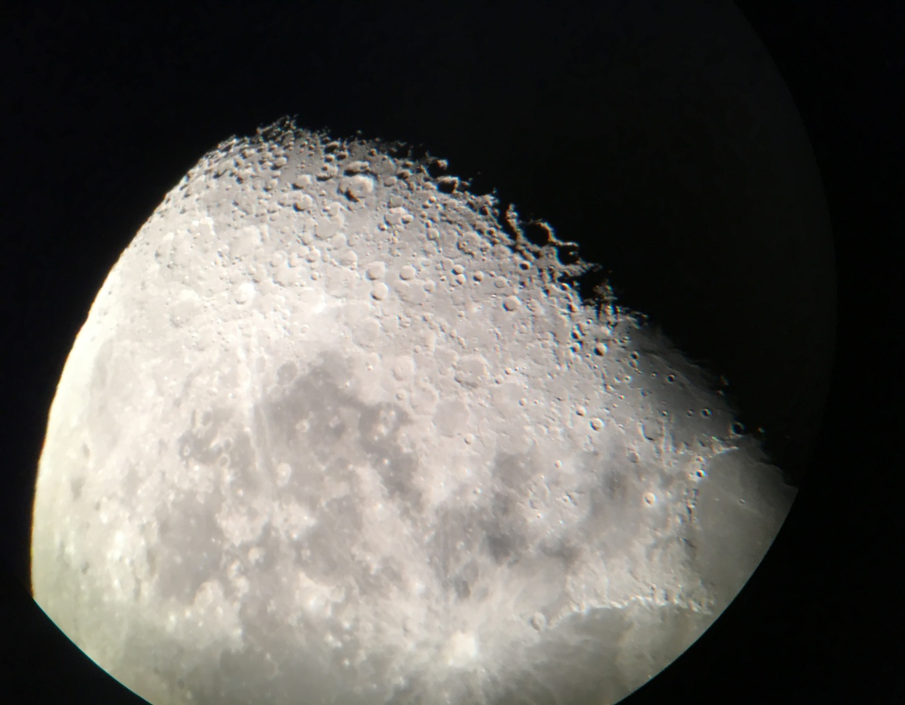
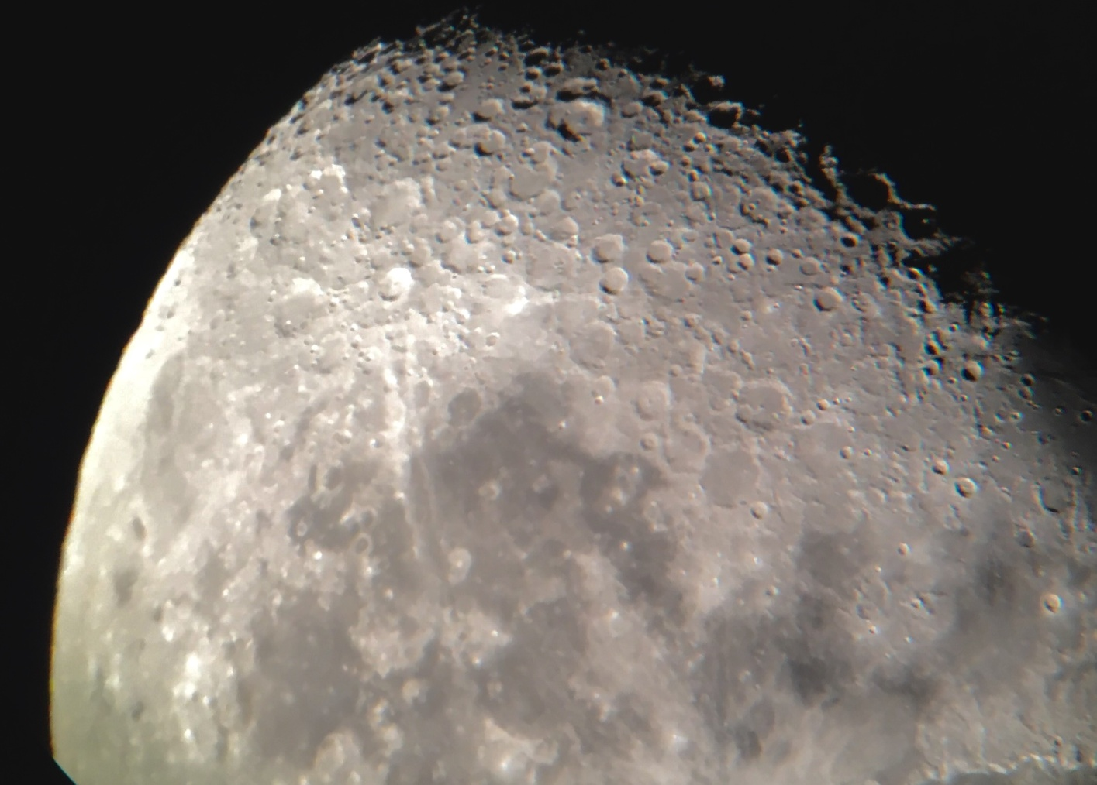
What can you expect to see in our scope?
Remember we talked about light gathering? Aperture?
The Moon as
viewed in our telescope
with no computer
assistance…
This image has been “cleaned
up” by using a computer program

Slide 15
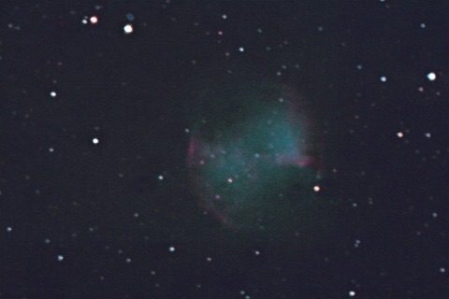
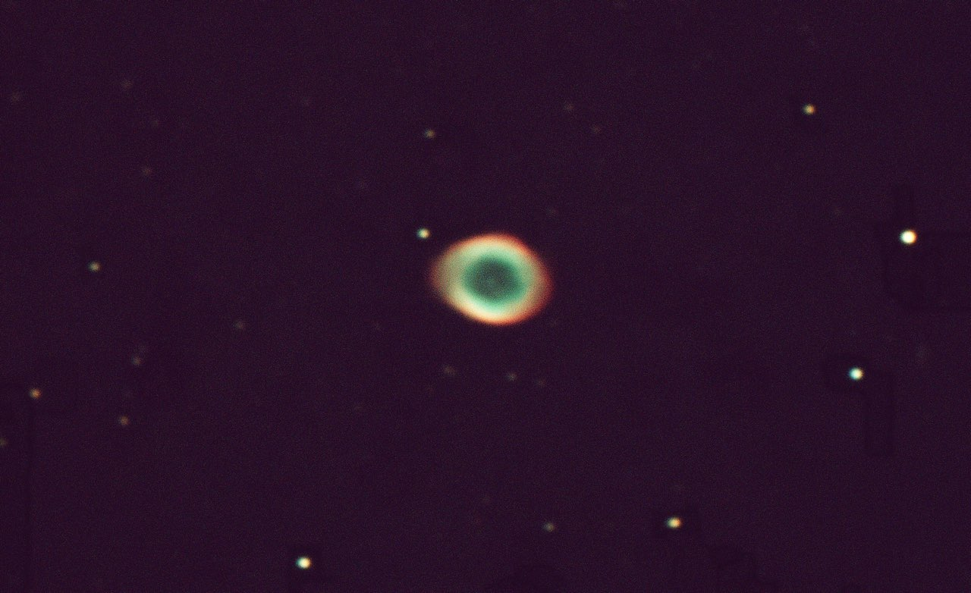
These images were taken using telescope camera, with a filter
hooked up to a computer.
Multiple images were taken over a period of about 20 minutes, the
computer program then stacked the images to give you the pictures
below.
M-27 Dumbbell Nebula
M-57 Ring Nebula

